Slide 1

Robust Cyber Security Threat Detection Systems
By - Aaryan Maheshwari (22BDO10001)
Chayan Gope (22BDO10036)

Slide 2
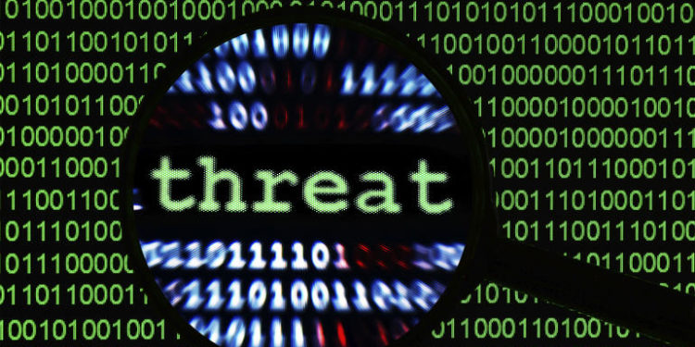
UNDERSTANDING THREAT DETECTION
Threat detection involves identifying potential security breaches and vulnerabilities within an organization's infrastructure.
Implementing effective systems is crucial for maintaining data integrity and operational continuity, especially in today's digital landscape.

Slide 3
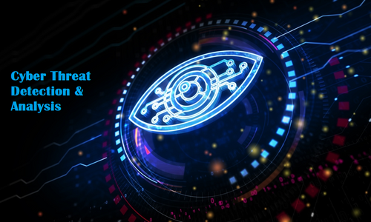
OBJECTIVES OF CYBERSECURITY THREAT DETECTION
⁠⁠Develop a comprehensive threat detection framework using machine learning algorithms.
⁠Implement real-time monitoring and alerting mechanisms for detecting and responding to cyber threats.
⁠Ensure the system can classify different types of threats accurately.
Integrate the system with existing network infrastructure and security tools.
Conduct extensive testing to evaluate the system's effectiveness and robustness.

Slide 4

TECHNOLOGIES WE WILL BE USING IN OUR PROJECT
Programming Languages: Python (for machine learning models), JavaScript (for front-end and real-time data visualization), Bash (for scripting).
Frameworks/Libraries: TensorFlow or PyTorch (for ML model development), Scikit-learn (for data preprocessing and modeling), ReactJS (for front-end).
Databases: MySQL/ (for storing logs and threat data), ElasticSearch (for real-time data indexing and searching).
Tools: Jupyter Notebook (for data analysis and model development).
Cloud Services: AWS(for scalable infrastructure and deployment, future scope)

Slide 5

EXPECTED RESULTS & IMPACTS
Threat Detection: High accuracy in detecting and classifying various cyber threats.
Real-Time Monitoring: Continuous monitoring with automated alerts and incident response.
Scalability: Flexible architecture that can adapt to different environments.
Compliance: Alignment with industry regulations and standards.

Slide 6

WHAT’S NEXT?
Completing data collection and beginning model development.
Research existing threat detection methodologies and understand the types of threats that need to be detected.
Continuous learning and updating of the system to adapt to new threats.
Expansion to include more advanced detection techniques like anomaly detection.

Slide 7
Thank You
Have a nice day ma’am!!

